Slide 1

Predicting Does it Rain Tomorrow
IOD – MiniProject 2 | Jeff

Slide 2
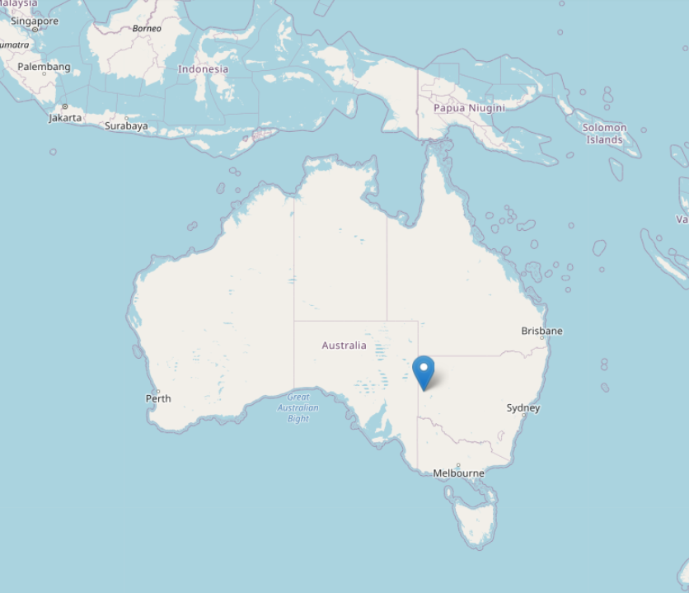
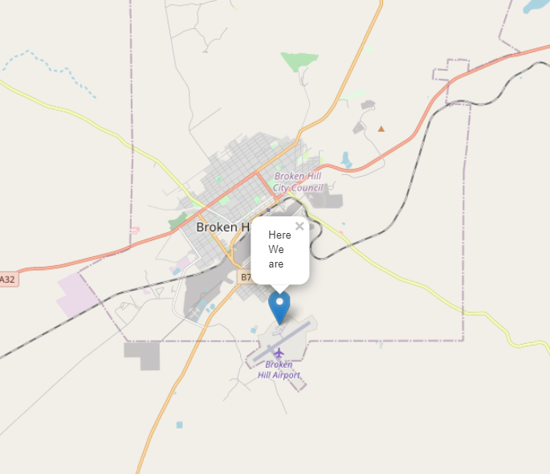
1 Introduction
Rainfall prediction is one of the challenging and uncertain tasks which has a significant impact on human society. Timely and accurate predictions can help to proactively reduce human and financial loss.
The location is a town called Broken Hill, in the far west of New South Wales of Australia. Broken Hill experiences some seasonal variation in monthly rainfall Throughout the year, in Broken Hill, there are 59.8 rainfall days.
Notes:
This case study is to help to predict whether or not it will rain tomorrow.
This study presents a set of experiments which involve the use of machine learning technique to build models to predict whether it is going to rain tomorrow or not based on weather data for that particular day. This study is concentrating on 3 aspects: modeling inputs, modeling methods, and pre-processing technique.
Bureau of Meteorology.
Broken Hill is a mining town in the far west of new south wales, in the Australia outback, the population is less than 18000.

Slide 3


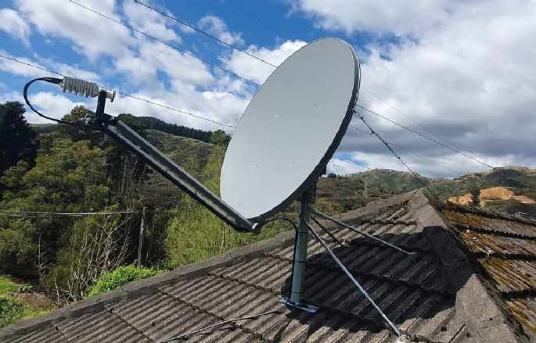
2 Stakeholder
Mining Company.
Satellite Operator.
Local residents

Slide 4
3 Use Case
Dataset Description
Feature | Description
Date | The date of observation
MinTemp | The minimum temperature in degrees celsius
MaxTemp | The maximum temperature in degrees celsius
Rainfall | The amount of rainfall recorded for the day in mm
Evaporation | The so-called Class A pan evaporation (mm) in the 24 hours to 9am
Sunshine | The number of hours of bright sunshine in the day.
WindGustDir | The direction of the strongest wind gust in the 24 hours to midnight
WindGustSpeed | The speed (km/h) of the strongest wind gust in the 24 hours to midnight
WindDir9am | Direction of the wind at 9am
WindDir3pm | Direction of the wind at 3pm
WindSpeed9am | Wind speed (km/hr) averaged over 10 minutes prior to 9am
WindSpeed3pm | Wind speed (km/hr) averaged over 10 minutes prior to 3pm
Humidity9am | Humidity (percent) at 9am
Humidity3pm | Humidity (percent) at 3pm
Pressure9am | Atmospheric pressure (hpa) reduced to mean sea level at 9am
Pressure3pm | Atmospheric pressure (hpa) reduced to mean sea level at 3pm
Cloud9am | Fraction of sky obscured by cloud at 9am.
Cloud3pm | Fraction of sky obscured by cloud at 3pm.
Temp9am | Temperature (degrees C) at 9am
Temp3pm | Temperature (degrees C) at 3pm
RainToday | 1 if precipitation exceeds 1mm, otherwise 0
RainTomorrow | The target variable. Did it rain tomorrow?
The dataset contains daily weather observation taken from a weather station in BHI airport for the past 14 months. The daily observations are available from http://www.bom.gov.au/climate/data.
It consists of 20 features and 408 rows.
Notes:
In this case study, the dataset used contains daily weather observations from a weather station in BHI ariport.
The target variable is RainTomorrow which means: Did it rain the next day? Yes or No.

Slide 5
4 Methodology
It includes 4 major components: Data Exploration and Analysis, Data Pre-processing, Model Implementation and Model Evaluation.
Data
Preprocessing
EDA
Evaluation
Modelling
Data exploration
Visualization
Missing Values
Categorizing
Feature Selection
Logistic Regression
KNN
Accuracy
Score

Slide 6
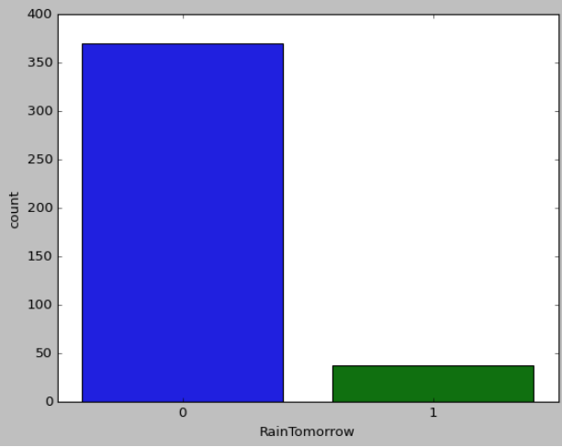

4.1 Data Exploration
Fig 1
Irrelevant Features
Feature | Null values
Sunshine | 408
Evaporation | 408
Cloud9am | 289
Cloud3pm | 270
The first 2 features – Sunshine and Evaporation has a 100% Null values. This could imply the feature is not relevant. While the other 2 features, we will fill it with the mean of the dataset.
The 2 features – RainTodayand RainTomorrow shown in Fig 2 and Fig 3 are very similar.
Fig 2
Fig 3

Slide 7
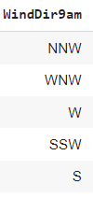
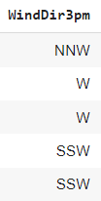
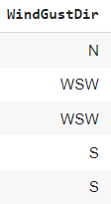
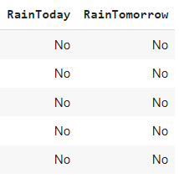
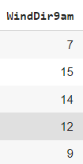
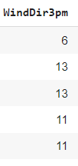
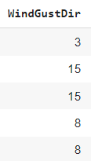
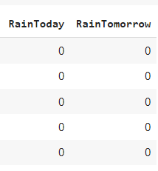
4.2 Data Preprocessing
Missing Values: In the previous slide, there were 4 features irrelevant, we will drop Sunshine, Evaporation from the columns, while we replace the null values in Cloud9am, Cloud3pm with the mean values.
Categorical features: We have a few categorical features – WindGustDir, WindDir9am, WindDir3pm, RainToday, RainTomorrow.
Notes:
Categorical features: We have a few categorical features – WindGustDir, WindDir9am, WindDir3pm, RainToday, RainTomorrow. Now it gets complicated for machines to understand texts and process them, since the models are based on mathematical equations and calculations. Therefore, we have to encode it.

Slide 8
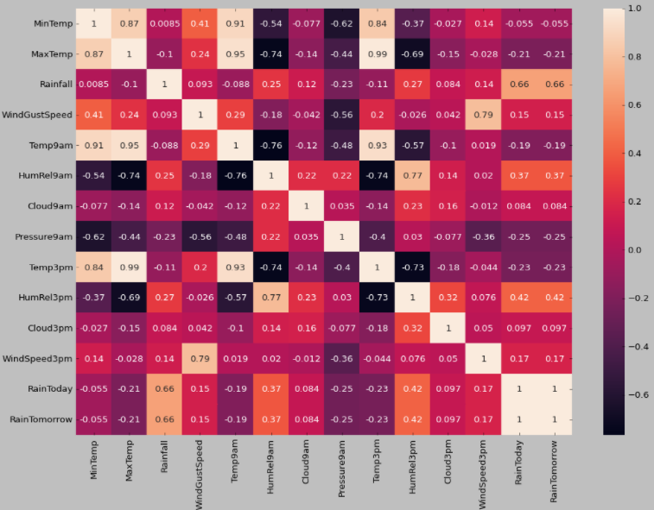
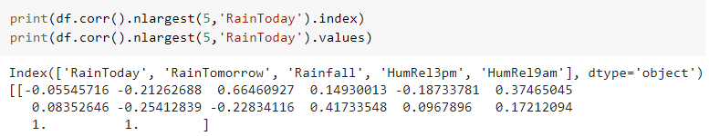
4.2 Data Preprocessing
Feature Selection: Using correlation matrix with heatmap to identify the relevant features.
We identify top 5 features – RainToday, RainTomorrow, Rainfall, Humidity Relative 9am, Humidity Relative 3pm.
Notes:
The correlation matrix depicts that the features - MaxTemp, Pressure9am, Pressure3pm, Temp3pm and Temp9am are negatively correlated with target variable.
Hence, we can drop this features in our feature selection step later.

Slide 9
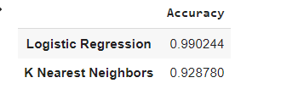
4.3 Evaluating
Evaluating the Algorithms: Before we train our model, we evaluate 2 algorithms to find the one that gives the best performance. We try with Logistic Regression and KNN.
Instead of splitting the dataset into training and testing sets, we use 10-fold cross-validation to obtain the average score of each algorithms.

Slide 10
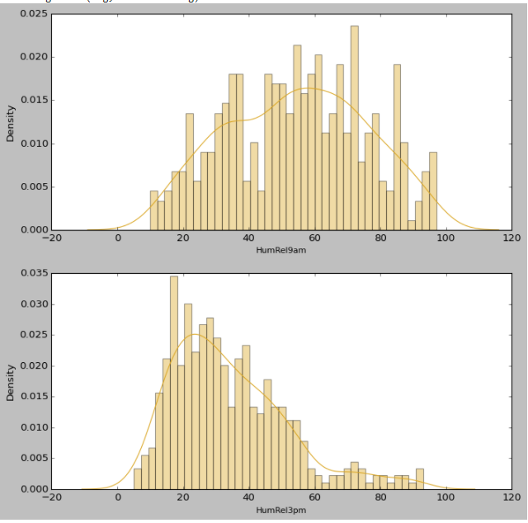
4.4 Model Implementation
Logistic Regression performed the best against KNN.
Conclusion:
Humidity has a strong correlation with the target variable. However, with further exploration we observed that Humidity at 9 AM and 3 PM are strongly related (based on the heatmap). We also observed that Raintoday and RainTomorrow are related.

Slide 11
Thank you

